Slide 1
“Parametric design and analysis of Machine Elements using Python ”
Project Presentation
C-298 | Yash Ramchandra Sarda | 71939582J
B-118 | Prasad Suresh Jagdale | 71939503J
C-244 | Harshal Dattatraya Sawant | 71939558F
B-111 | Ishan Anand Prabhune | 71939502L
 | Guided by :- Dr.S.S.Mulik Sir
Department of Mechanical Engineering
RMD- Sinhgad, Pune
2020-21

Slide 2
Agenda
Introduction
Problem Statement.
Objectives.
Methodology.
Tools and Software Used.
Elements implemented.
Screen Shots of project.
Advantages.
Summary.
References.

Slide 3
Introduction
As everything is moving towards Automation we got idea to automate our design works. With the help of Python and its modules we are trying to make the tired and time consuming work easy and finish within just some few minutes.We also had added functionality to plot the Shear Force and Bending Moment diagram or to save it as an image as user want which could be used to further analyse.It is an awesome opportunity to integrate our knowledge of 3 years of engineering with the computer programming.
Notes:
S

Slide 4
Problem Statement
In the era of technology everything is moving towards Automation.
We thought that designing and analysis must also be automated to save time and money of brilliant engineers and designers.
As when we were learning the CATIA and AutoCAD. We realised what hard work, determination and time it requires.
So we are making a demo type model of Automation of design software and also doing analysis of designed elements
Notes:
This is expected to be domain oriented. If the Project is not confirm and decided, then the Statement may by domain specific.
Instead, the student may talk on maximum 2 points
1 point shall be based on company introduction in case of sponsored projects
1 point shall be based on relevance of the project tentatively decided/ or the list of projects which are suggested by guide or student are planning to take.

Slide 5
Objectives
To save time for designing.
To save time for calculations.
To automate the designing process.
To make the work of Engineers easy.
Notes:
If the Project is not confirm and decided, then this slide may be skipped.

Slide 6
Software used
Python → Programming language.
AutoCAD → Design Software.
Pandas → To store & retrieve data. Database.
VS Code → TO Write Python Programs.
Notes:
In case the students have done any literature review, if not done, this slide should be not be included in the presentation.

Slide 7
Modules Used
Modules : They are Small Program inbuilt in Python to enhance the functionality of Python Programs.
1) Math → To perform Mathematical Function
2) Matplotlib → To Plot Graphs, SFD, BMD.
3) Turtle → A Drawing Module of Python to plot CNC Drawing.
4) Tkinter → An API (Application Programming Interface) to create GUI (Graphical User Interface).
5) PyAutoCAD → An API to send commands to AutoCAD from Python.

Slide 8
Elements implemented
In our project We had chosen 3 elements to design.
Cotter Pin
Knuckle Pin
Shaft
Notes:
This is maximum 2 points
This shall address the issues like what has made you to take up this as project work, based on expertise available, infrastructure available, state of art technology involved, significance in employability, etc.
This may address the expertize available with the students and skill sets required to bring up the project.

Slide 9
Some extras..
We had also made the program of plotting the diagram before going to CNC MACHINE by writing or giving same code of CNC machine.
We had implemented absolute programming for easy reference of points.
For it we had to use Turtle software which would convert the Python code in 2D diagram in Cartesian Coordinate system.
We had used Absolute Programming Method.

Slide 10
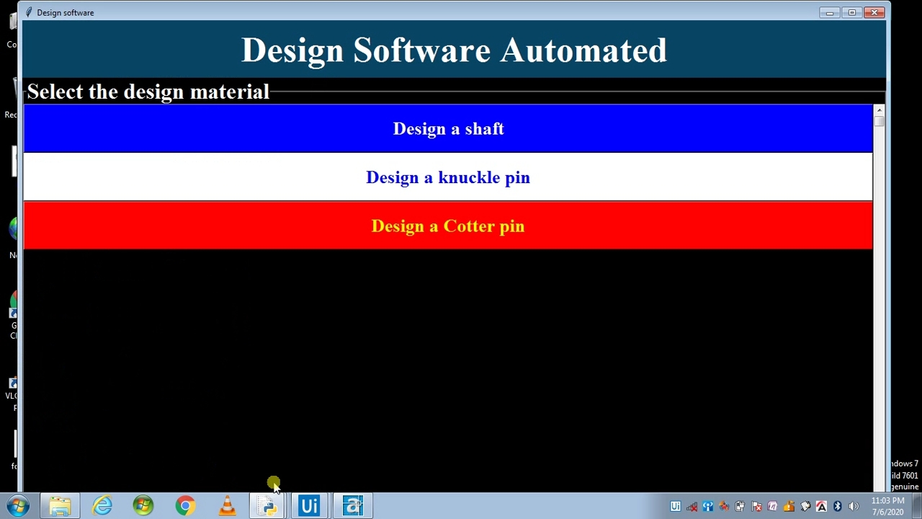
Some Screen Shot of our project
Notes:
In case the students have done any literature review, if not done, this slide should be not be included in the presentation.

Slide 11
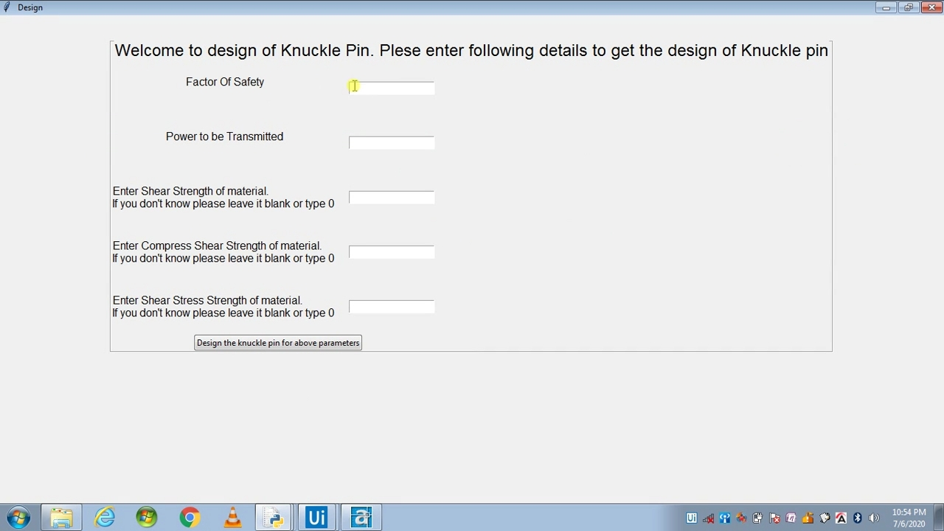
Example: Problem of knuckle pin

Slide 12
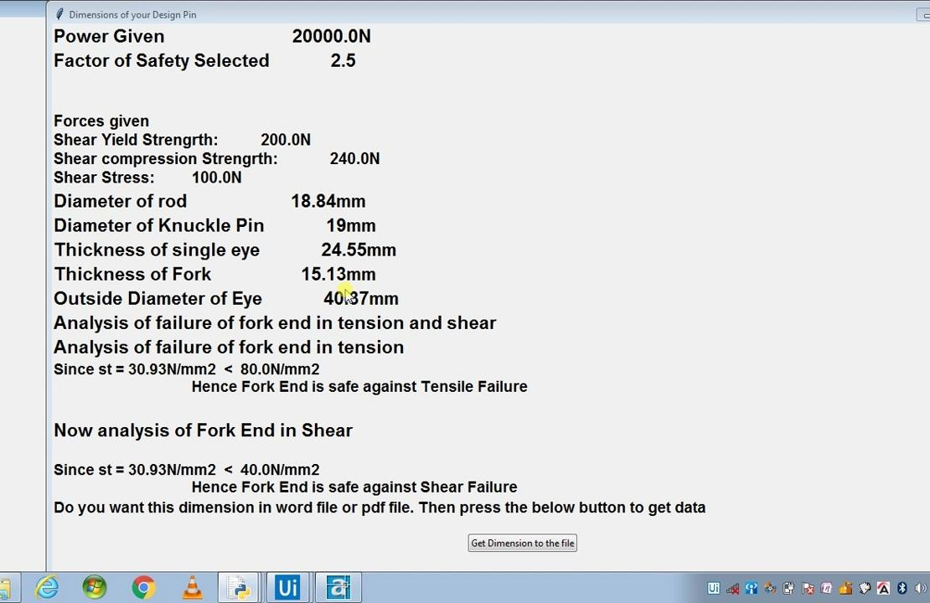
And its solution
Notes:
What in short students would like to tell about the project.

Slide 13
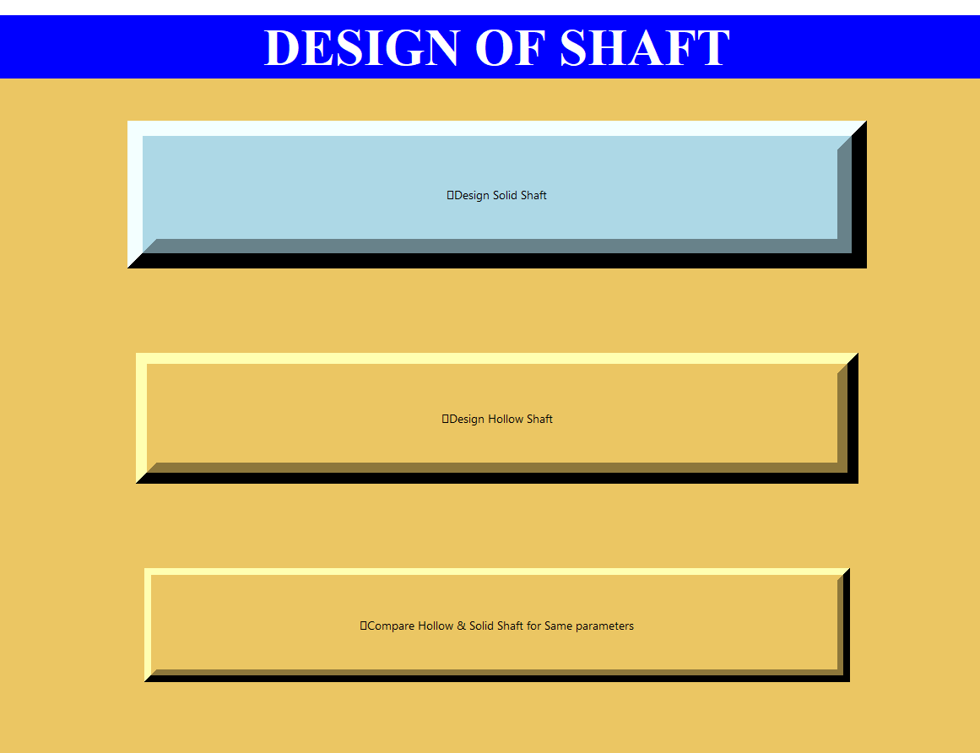
Design of Shaft

Slide 14
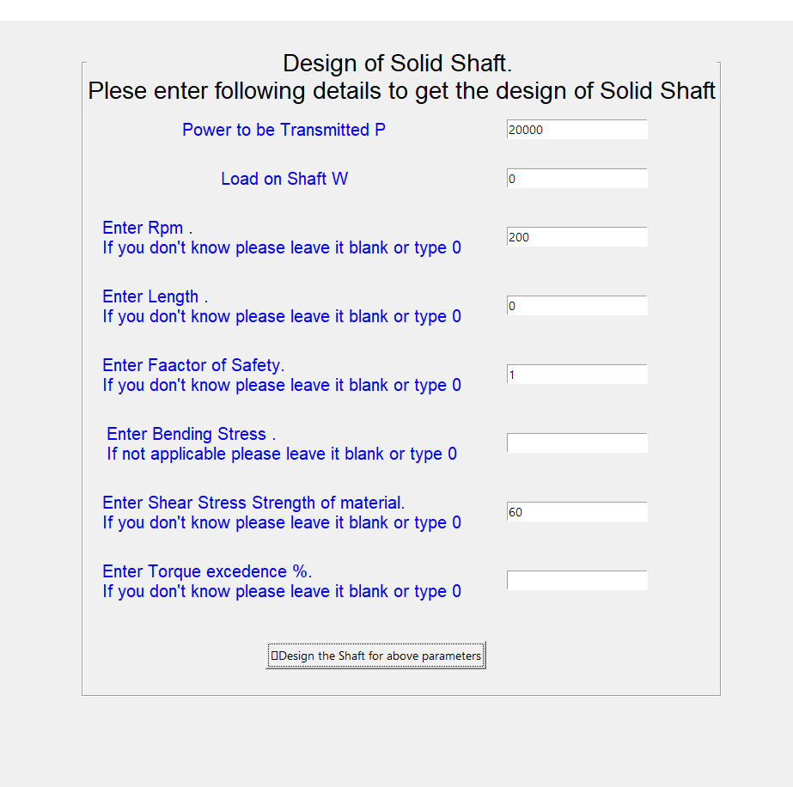

Slide 15
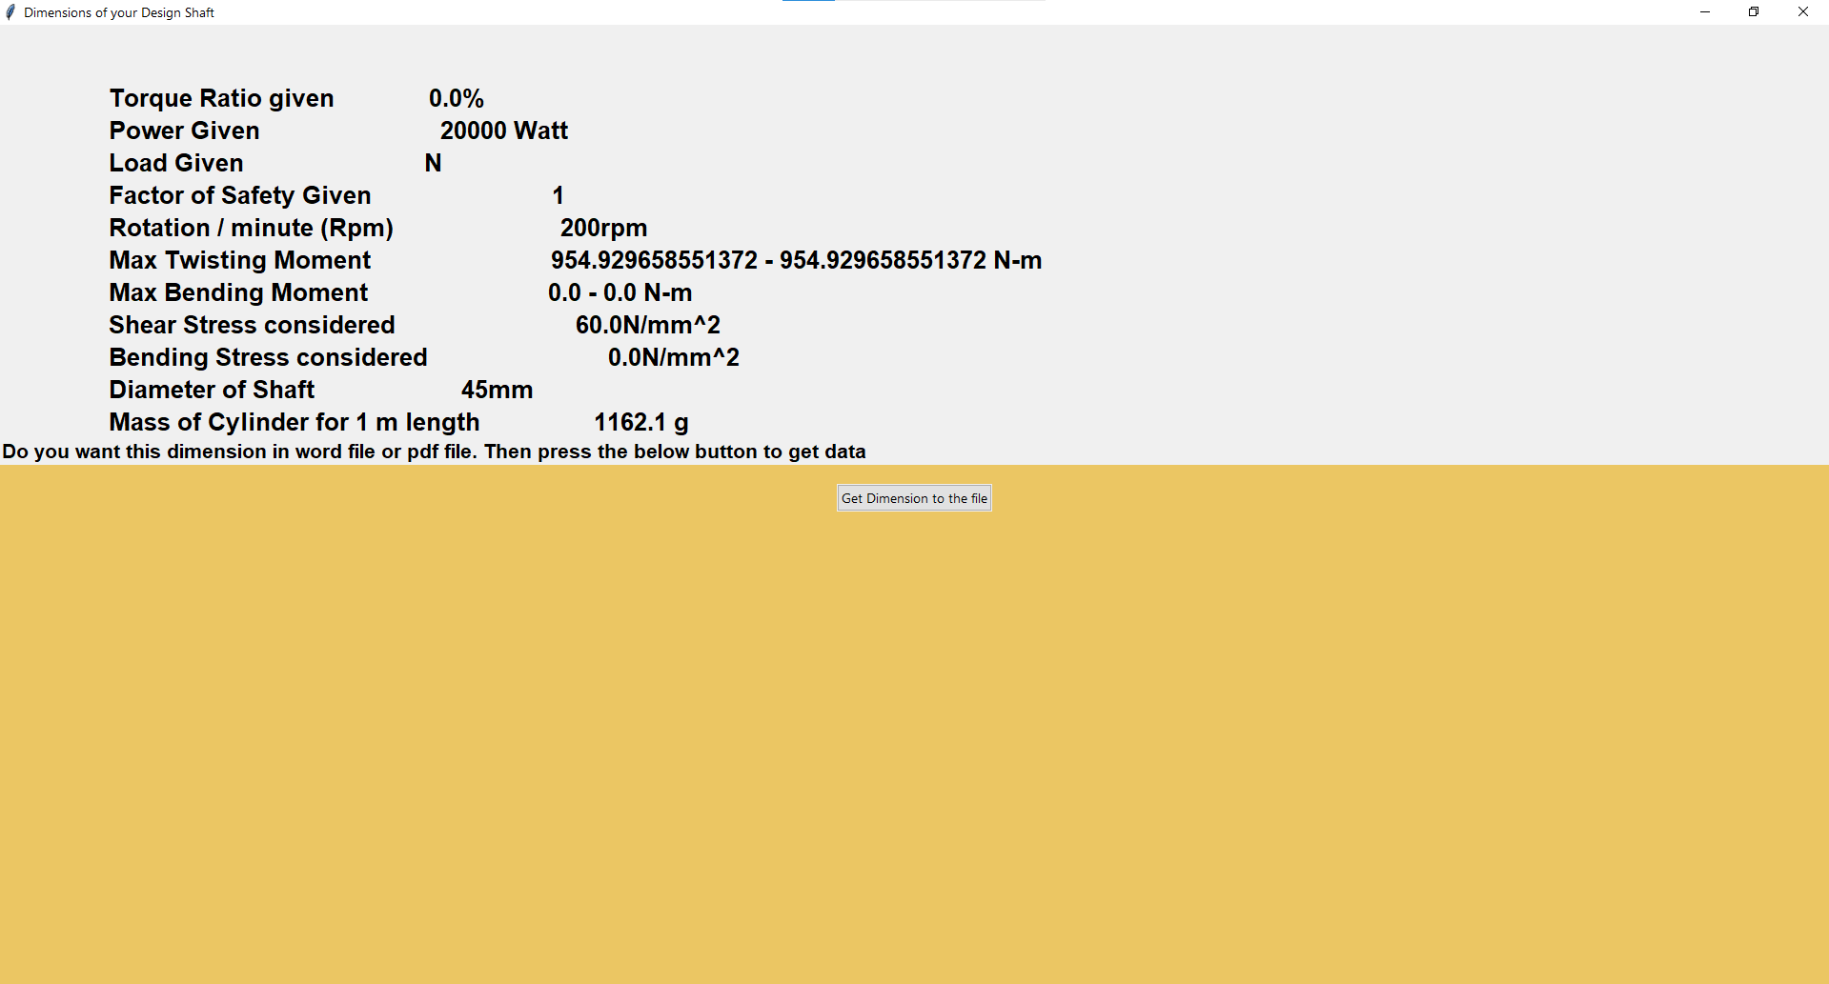

Slide 16
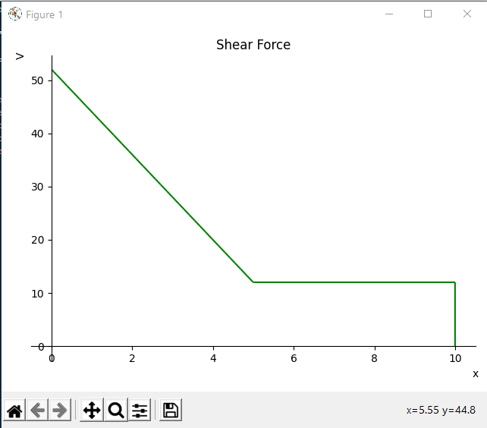
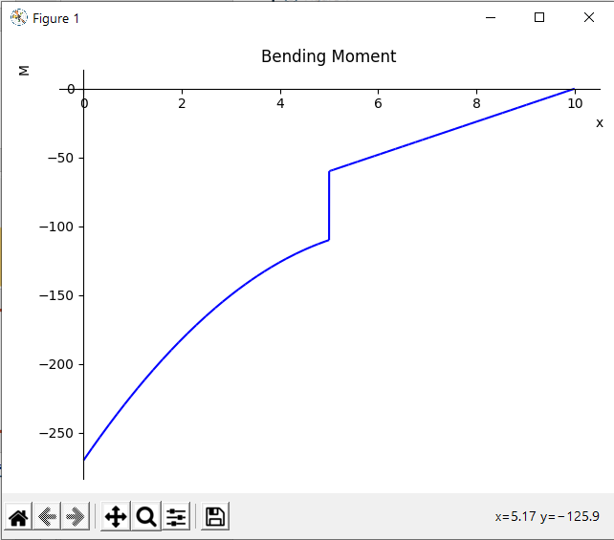
Shear Force Diagram
Bending Moment Diagram

Slide 17
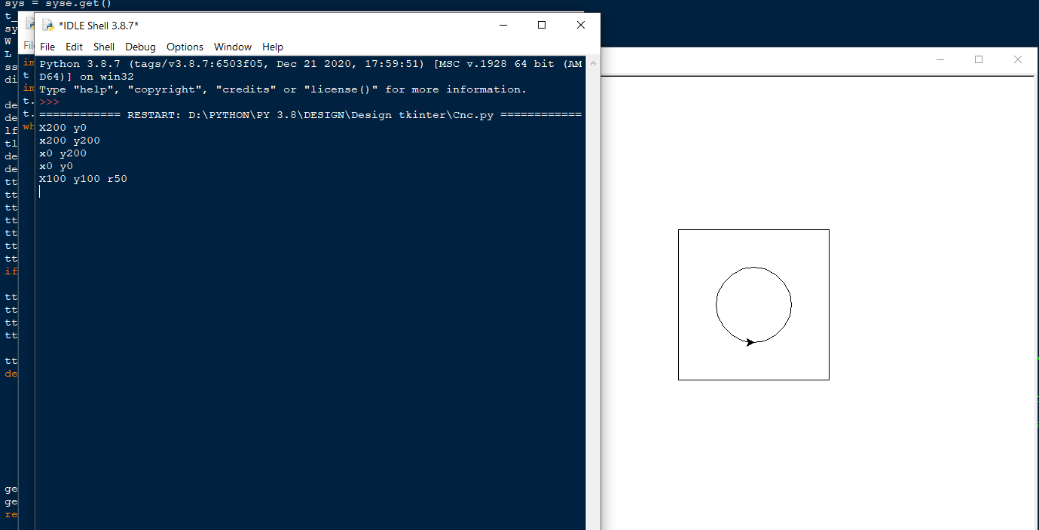
CNC Demo with coordinates on left side while output on right side

Slide 18
Advantages
Easy to use.
Easy to implement.
Save time.
Quick and correct analysis.
Wide range of applications.
No headache of lengthy and complex calculations.

Slide 19
Summary
We had done this project to enhance our process of designing a step forward. With this we are trying to make the design process less tired and time consuming from previous headache one. We are also trying to implement some theories of thermodynamics to make our model more better. Though we had done much progress in recent few decades but in a world, moving towards Automations why design process should be a complex one in today’s era ?

Slide 20
References
www.python.org/docs.com
www.github.com
https://pypi.org/project/pyautocad
https://pyautocad.readthedocs.io
https://www.youtube.com
Notes:
These questions shall be asked by the panel of teachers reviewing it.

